Slide 1
IPADS IN THE PRIMARY LIBRARY
http://bit.ly/1H5Ukqt
Free apps for this session
Chrome
Side by Side
Paper
Sketchworthy
Skitch
Popplet (lite)
Tellagami
Chatterpix Kids (iphone)
YakiT Kids (iphone)
Thinglink
Steve Parish Postcards
Paid apps used this session
(optional to download)
WordPack ($1.29)
WordFoto ($2.49)
TypeDrawing ($2.49)
Superimpose ($1.29)
Presented by Laura Chaffey
Twitter: @laurachaffey
Website: http://ictwithmissc.weebly.com
Class blog: http://tjps2c.weebly.com

Slide 2
AIR SERVER
Airplay your iPad to a PC screen. Share up to 12 screens at a time. Excellent way to share work or to monitor iPad usage.
Education License - $14.99 each or price is lowered to $12.99 when 10 or more licenses are purchased.
Free trial available – head to - http://www.airserver.com/Download

Slide 3
CHROME
Chrome prompts for authentication each time browser is opened for a more secure browsing experience.
To Disable Safari
Settings > General > Enable Restrictions > turn off Safari

Slide 4
SIDE BY SIDE
Free version – Ad supported
Paid version ($2.49) – Ad free
Allows multiple windows to be open at once allowing you to browse several different websites or view a website and take notes on the same screen.

Slide 5
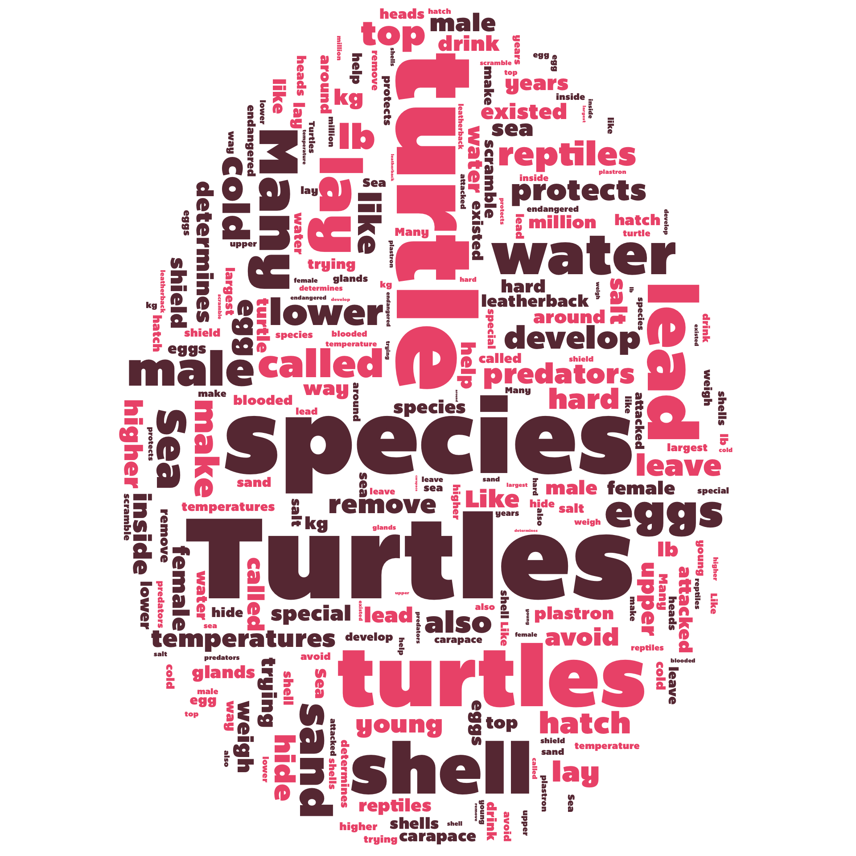
WORD PACK
$1.29
Create word clouds in a variety of
shapes and designs.
Use as a before and after activity
Analyse a website

Slide 6
PAPER
Free

Slide 7
SKETCHWORTHY
Currently Free
Note taking app
Draw on blank paper, photos, drawings, maps and even websites!

Slide 8
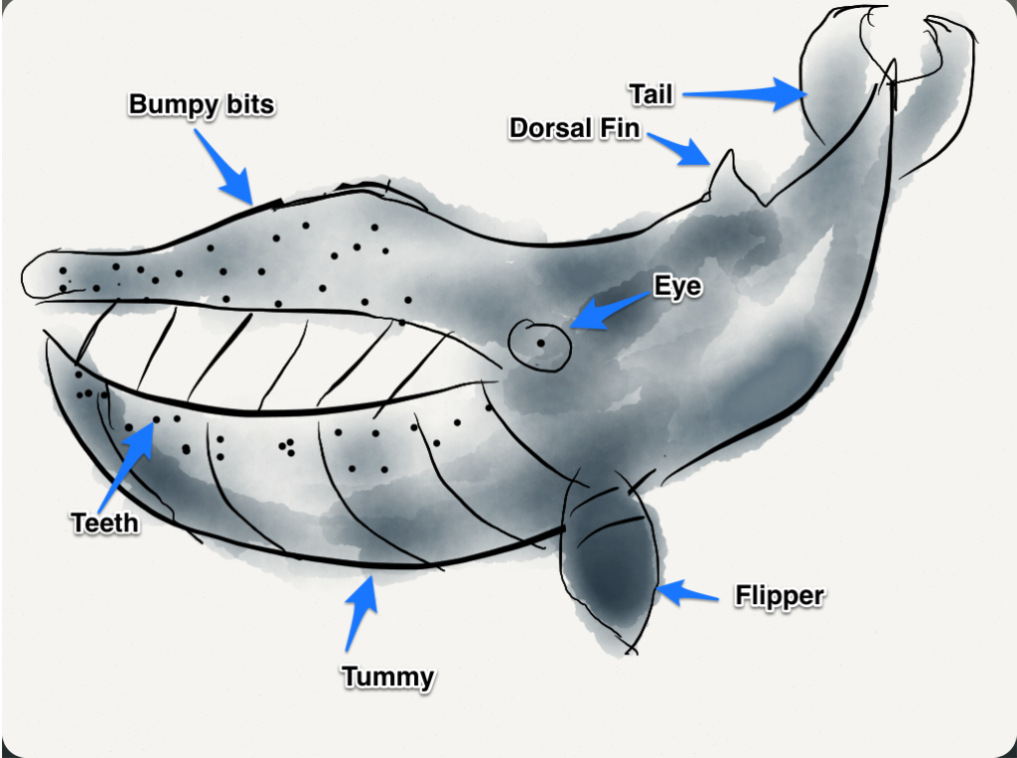
SKITCH
What could it be used for?
A basic note taking app.
Excellent for labelling activities.
Combine with paper app to have
students draw own diagrams and
label.
PRO TIP: www.photosforclass.com

Slide 9
POPPLET
Popplet (Lite) – Free
Popplet - $6.49 (currently 60% off)
Excellent brainstorming/ mind mapping tool
Add text or images with a single click.
Online account has even more options.

Slide 10
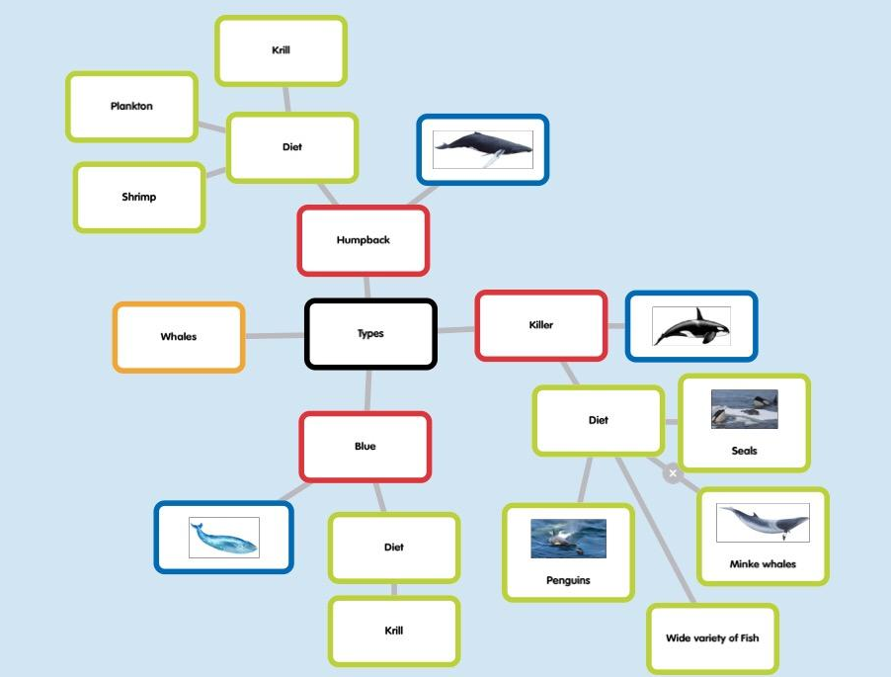

Slide 11
OTHER BRAINSTORMING APPS
All have free versions available
Inspiration
Total Recall
BigMind – Mind mapping

Slide 12
APPS TO MAKE AWESOME PRESENTATIONS!

Slide 13
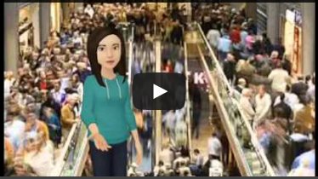
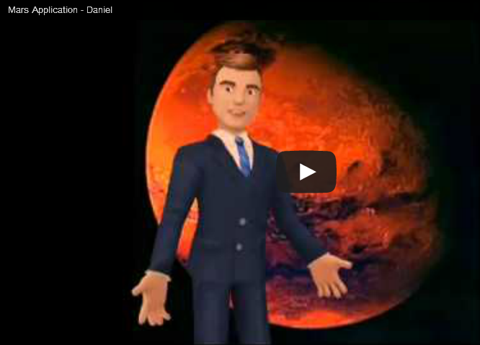
TELLAGAMI
What could it be used for?
Narrative
Fast Facts segment
Character introductions
Book reviews
Online safety briefing
PRO TIP : Use a solid green
background to mimic a
green screen
Persuasive arguments
Weather report

Slide 14
CHATTERPIX KIDS
& YAKIT KIDS
Create talking characters!
Turn your own drawings into talking characters
Take a photo of a drawing and make it talk
Photograph a puppet or inanimate object and bring it to life!
PRO TIP: Use iMovie to combine multiple clips to make a longer video

Slide 15
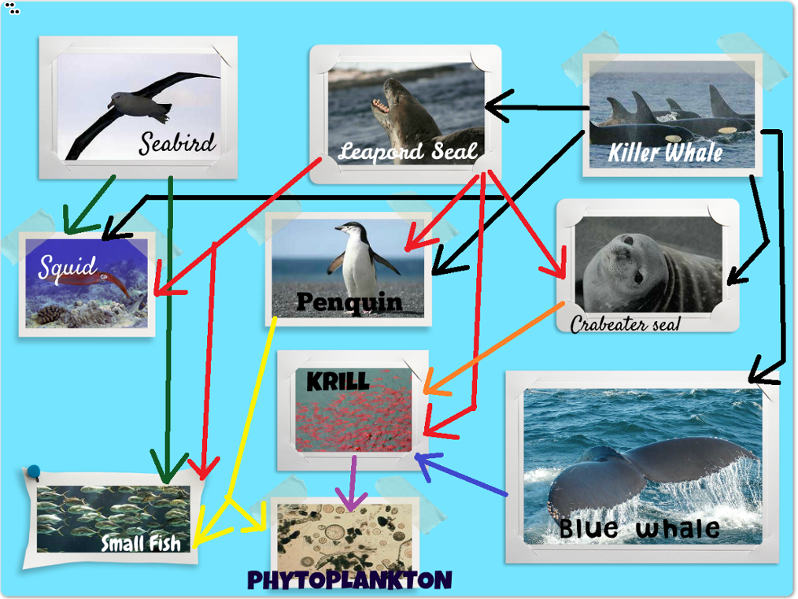
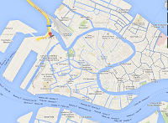
THINGLINK
APP & WEBSITE - CREATE AN ACCOUNT ONLINE
Create interactive images at
link to text, images, urls, videos, anything!
How can I use it?
Food Webs
Resource Hubs
Story predictions
Mapping

Slide 16
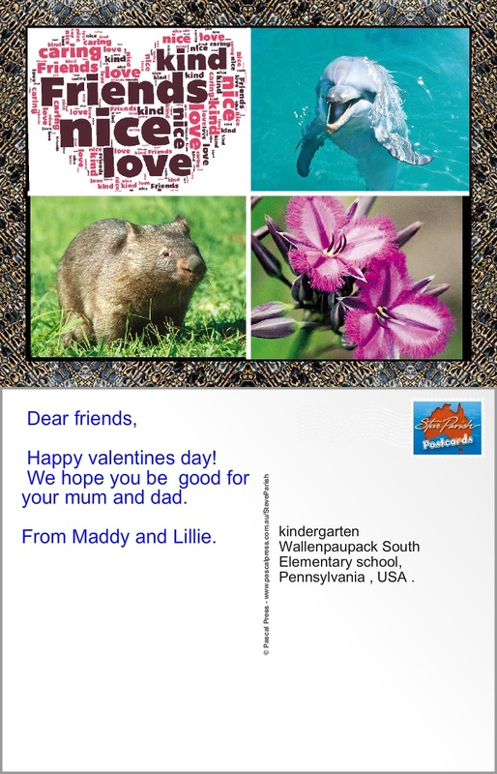
STEVE PARISH POSTCARDS
Write a letter from one character to another.
Write a postcard describing a landmark you are visiting.
Global connection projects.
Can be emailed directly from the app or saved as an image.

Slide 17
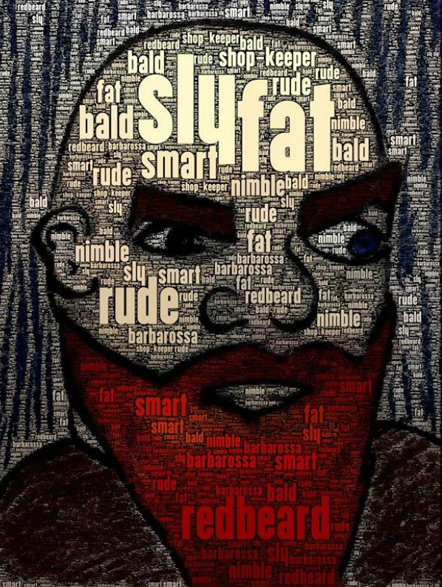
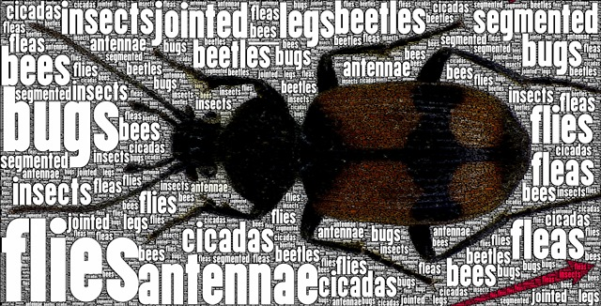
WORD FOTO
$2.49
Integrate text with you image to create amazing typographic works of art.
Create character profiles
Science word bank
Etymological word study

Slide 18
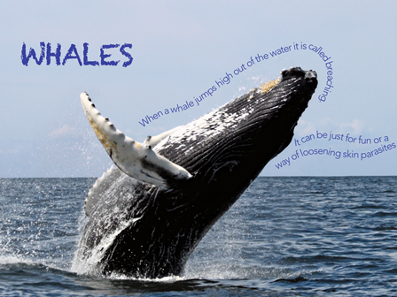
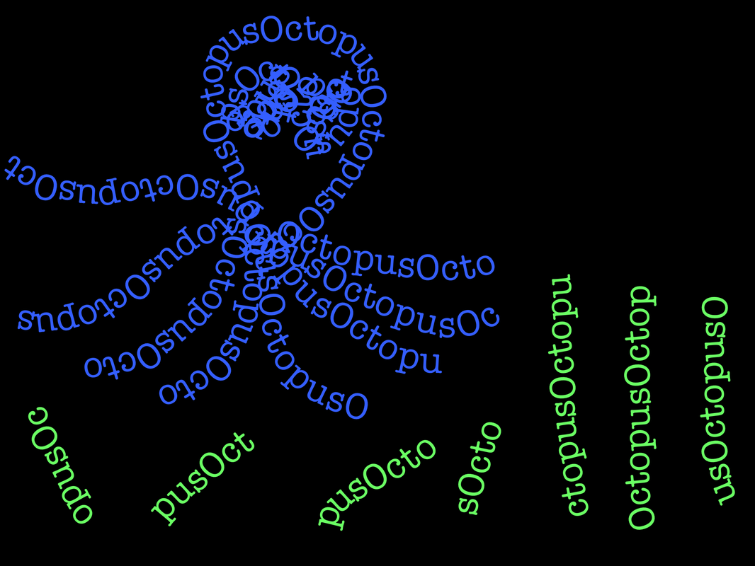
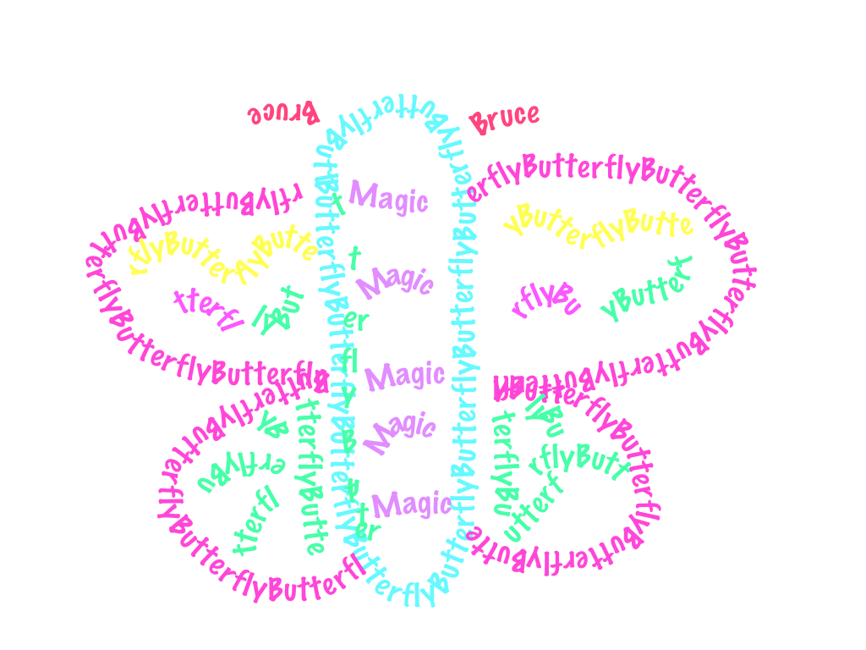
TYPE DRAWING
$2.49
Overlays text over the image to create amazing typographic works of art.
Create images using only text.
Overlay text over an image.

Slide 19
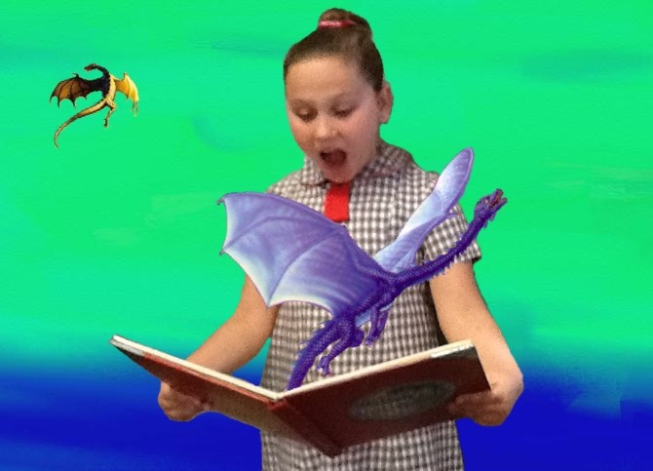
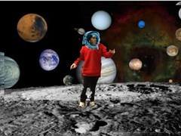
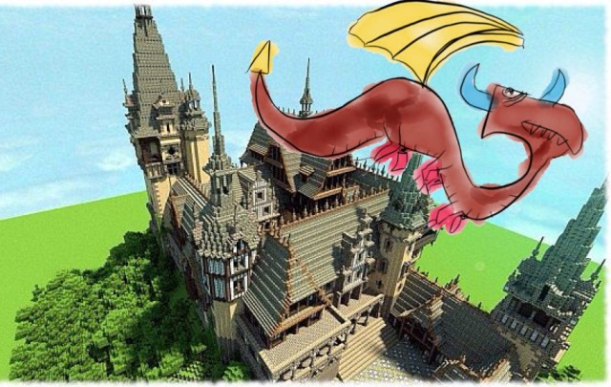
SUPERIMPOSE
$1.29
Create images made of two layers.
Place one image over a background and use masking tools to erase unwanted areas.

